Slide 1


Vehicle Loan Default Prediction
Sashidhar Bezawada

Slide 2
Agenda
Introduction
Dataset & Source
Data Transformation
Exploratory Data Analysis
Risks / Contingencies
Models & Metrics
Result Interpretation
Conclusion
References

Slide 3


Introduction
Financial institutions incur significant losses due to the default of vehicle loans. This has led to the tightening up of vehicle loan underwriting and increased vehicle loan rejection rates. The need for a better credit risk scoring model is also raised by these institutions. This warrants a study to estimate the determinants of vehicle loan default.
Financial institutions have the need to accurately predict the probability of borrower defaulting on a vehicle loan in the first EMI (Equated Monthly Instalments) on the due date. Doing so will ensure that clients capable of repayment are not rejected and important determinants can be identified which can be further used for minimizing the default rates.
Financial institutions are using classification models to predict the default or raise red flags on the accounts which are likely to default. One major problem is of Imbalanced Distribution of classes i.e. the available training data consists more of non-default accounts vs. default accounts.

Slide 4
Dataset & Source
The Dataset with the following information regarding the loan and borrower will be used:
Borrower Information : Demographic data like age, income, Identity proof etc.
Loan Information : Disbursal details, amount, EMI, loan to value ratio etc.
Bureau data : Bureau score, number of active accounts, status of other loans, credit history.
train.csv : has 41 Columns & 233154 records
test.csv : has 40 Columns & 112392 records

Slide 5
Data Transformation
I have performed the NULL value inspection and have added the Missing values for the Variable Employment_type with default values (“Missing”).
I have also performed Variable Inspection and changed the types of the below variables.
AVERAGE_ACCT_AGE, CREDIT_HISTORY_LENGTH are object, changed to int.
DATE_OF_BIRTH & DISBURSAL_DATE are object, changed to datetime

Slide 6
Exploratory Data Analysis

Slide 7
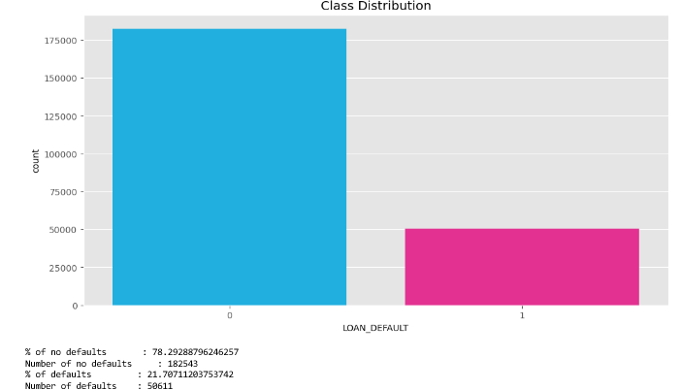
Exploratory Data Analysis
Class distribution for the variable - LOAN_DEFAULT

Slide 8
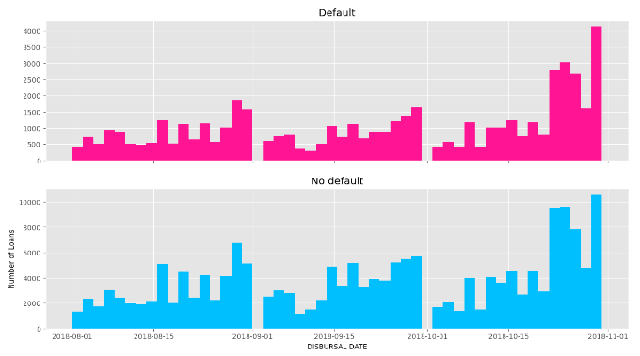
Exploratory Data Analysis (Cont…)
Default vs Disbursal dates :
loan defaults were on the higher side during the end of 2018-October.

Slide 9
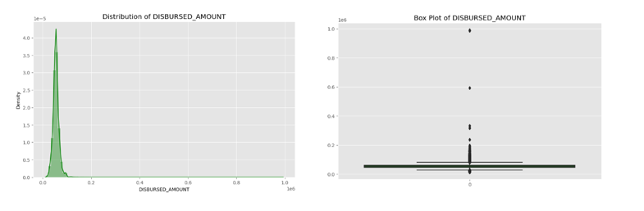
Exploratory Data Analysis (Cont…)
Outlier Treatment & Binning :
disbursed_amount , asset_cost, LTV , Perform_CNS_Score, PRI_NO_OF_ACCTS, PRI_OVERDUE_ACCTS
New variables are created :
DISBURSED_AMOUNT_new,DISBURSED_AMOUNT_bins, ASSET_COST_new , ASSET_COST_bins , LTV_new , LTV_bins , PERFORM_CNS_SCORE_bins, PRI_NO_OF_ACCTS_bins, PRI_OVERDUE_ACCTS_bins

Slide 10
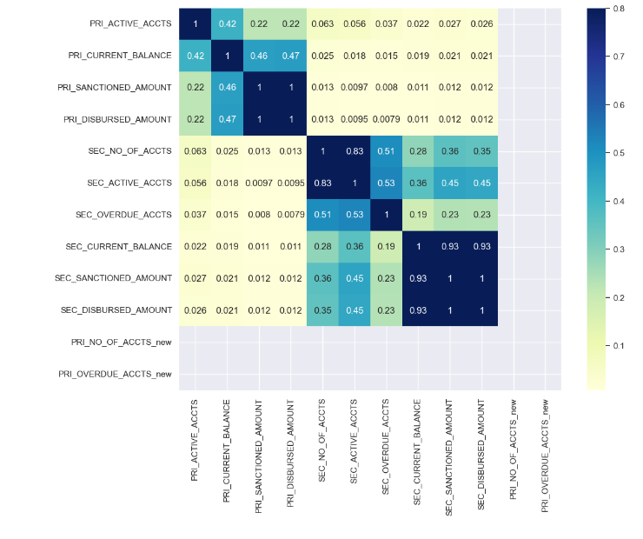
Exploratory Data Analysis (Cont…)
Heat maps to identify the correlation :
Keeping the variables due to the positive correlation –
'PRI_NO_OF_ACCTS_new', 'PRI_OVERDUE_ACCTS_new’ are perfectly positively correlated and hence keeping one
'SEC_NO_OF_ACCTS', 'SEC_ACTIVE_ACCTS' are highly positively correlated, hence keeping one
'SEC_CURRENT_BALANCE', 'SEC_SANCTIONED_AMOUNT', 'SEC_DISBURSED_AMOUNT' are highly positively correlated, hence keeping one
'AVERAGE_ACCT_AGE', 'CREDIT_HISTORY_LENGTH'are highly positively correlated and hence keeping one

Slide 11
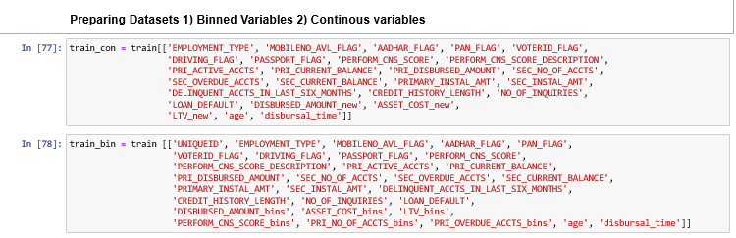
Exploratory Data Analysis (Cont…)
Based on the above EDA, these are the final train & test datasets with Binned & continuous variables.

Slide 12
Risks / Contingencies
Since the dataset is small and simulated dataset, it is highly possible that few models may perform poorly on the data hence as a contingency plan, I have aimed to apply multiple models and compare the results but still results may not be aligned with real world scenario, but I take this opportunity in validating my understanding with end-to-end flow of applying predictive analytics to a problem.
In general, such datasets would be imbalanced so I am keeping close tab on sampling (under/over).
And will be using SMOTE, to generate new and synthetic data, which can be used for training our model.

Slide 13
Models & Metrics

Slide 14
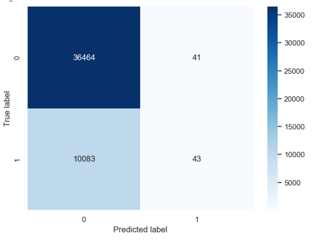
Logistic Regression
Accuracy of model 0.7828912097102786
F1 Score 0.00842311459353575
Recall Score 0.004246494173414972
AUC Score 0.5015616801780649
Balanced Accuracy Score0.5015616801780648
Accuracy score is good, however the model is not predicting the Defaults well

Slide 15
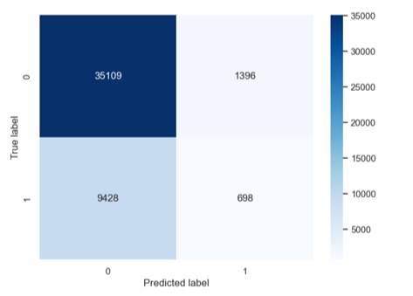
Random Forest
Accuracy of model 0.7678797366558727
F1 Score 0.11423895253682488
Recall Score 0.06893146355915465
AUC Score 0.5153450633779886
Balanced Accuracy Score0.5153450633779885
Accuracy score is good, however the model is predicting the Defaults better than Logistic reg

Slide 16
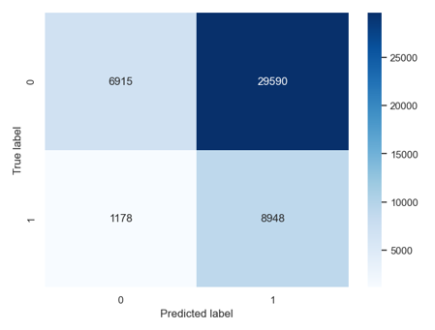
Naive Bayes
Accuracy of model 0.34018142437434323
F1 Score 0.36774617787276015
Recall Score 0.8836658107841201
AUC Score 0.5365459583984975
Balanced Accuracy Score 0.5365459583984975
Model accuracy is very poor

Slide 17
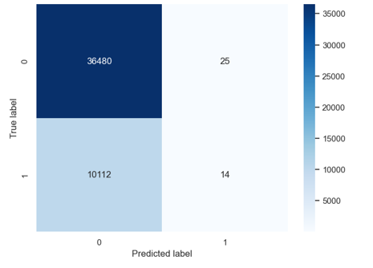
Stochastic Gradient Descent
Accuracy of model 0.7826124252106967
F1 Score 0.002754549926217413
Recall Score 0.0013825794983211535
AUC Score 0.5003488709024272
Balanced Accuracy Score0.5003488709024273
Accuracy score is good, however the model is not predicting the Defaults well

Slide 18
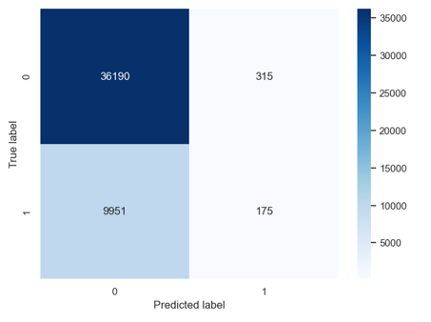
Decision tree
Accuracy of model 0.7798460251763848
F1 Score 0.03296910324039186
Recall Score 0.017282243729014417
AUC Score 0.5043266443956673
Balanced Accuracy Score 0.5043266443956673
Accuracy score is good, however the model is not predicting the Defaults well

Slide 19
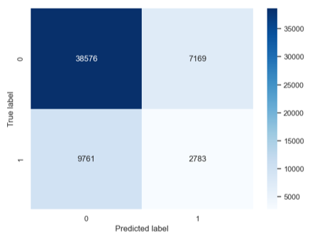
Random Forest ( SMOTE )
Accuracy of model 0.7095506870936197
F1 Score 0.24742176386913228
Recall Score 0.22185905612244897
AUC Score 0.53257123753767
Balanced Accuracy Score 0.53257123753767
The accuracy of RF might have gone down by 7% but is predicting defaults better now.

Slide 20
Result Interpretation
& Conclusion

Slide 21
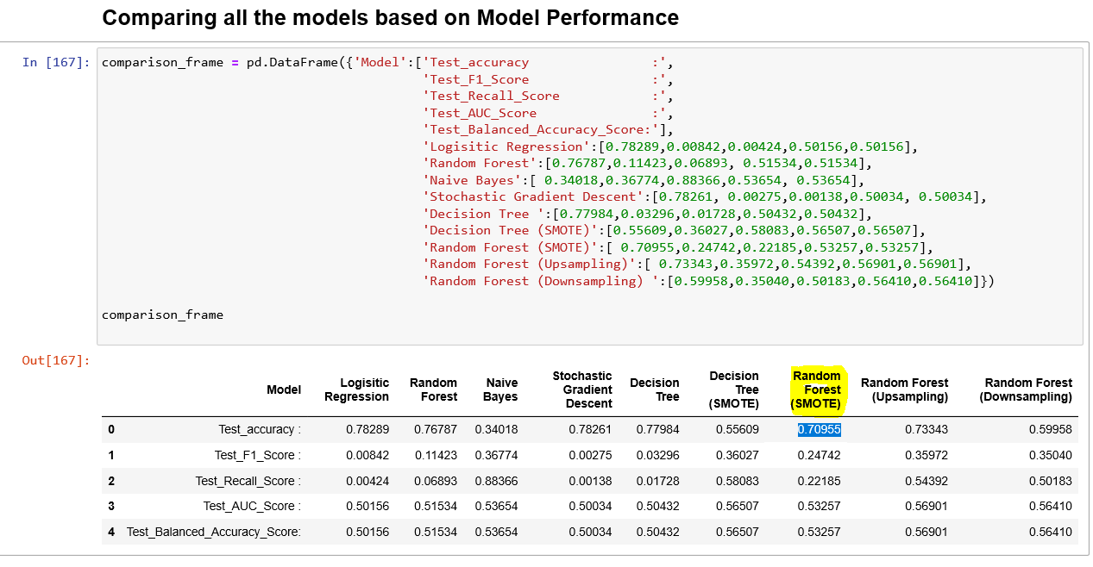
Result Interpretation
The Logistic Regression model achieved higher accuracy of 78.289% compared to other models. However, the model is not predicting the Defaults well.
Random Forest models performed better than other models in predicting the Defaults, indicating they have learned something useful.
The Random Forest model ( SMOTE ) had higher F1-Score of 24.724% than Random Forest model ( without SMOTE) with 11.423%.
The Random Forest model ( SMOTE ) had higher Recall Score of 22.185% than Random Forest model ( without SMOTE) with 10.995%.. When the model predicted positive, the Decision Tree was slightly more likely to be correct.
The ROC AUC score was higher for Logistic Regression (53.257%) compared to the other models considered useful.
The confusion matrices and classification metrics like false positive rate illustrate the types of errors made by each model. The Random Forest model had fewer false positives than Stochastic Gradient Descent & Decision Tree models.

Slide 22
Conclusion
Based on the metrics from different Model, my conclusion is that the best result is obtained by Random Forest after deploying [ SMOTE ], as it has better Recall score (22.18%) along with 70.95% accuracy.
Few key insights to highlight are ASSET_COST, LTV, PERFORM_CNS_SCORE, PRI_NO_OF_ACCTS, PRI_OVERDUE_ACCTS.
Chances of a customer to default a loan is more with Self employed is more than Salaried.
Customer with just more than one account have less chance to default.
Customer with no credit bureau are more likely to default.
Customers with LTV high have more likely chance to default.

Slide 23
References
1. Avik Paul. " Vehicle Loan Default Prediction “
https://www.kaggle.com/datasets/avikpaul4u/vehicle-loan-default-prediction
2. AMAN MIGLANI. “Predicting Loan Default (Classification)”.
https://www.kaggle.com/code/datatattle/predicting-loan-default-classification#Best-result-is-obtained-by-Random-Forest-after-deploying--SMOTE

Slide 24
THANK YOU

